Slide 1
Lent Week 8 Presentation

Slide 2
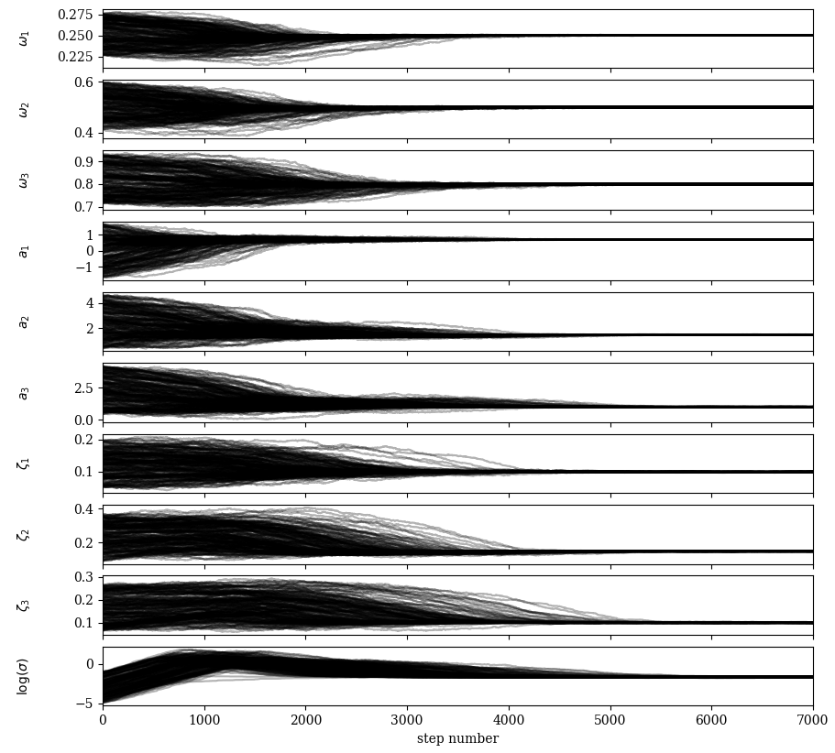
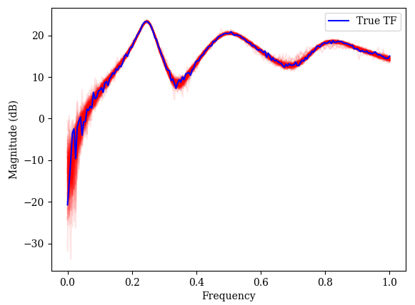
pCN
Implemented myself in Python, should be more efficient in higher dimensional spaces
Requires gaussian priors
Need to tune step size parameter
200 walkers, ~10 seconds

Slide 3
On 3C6 data pCN works, but still very slow. Hasn’t solved problem.
Instead, tried to use another package for MCMC sampling that has support for a variety of methods
Changed likelihood to match TF (in dB) as opposed to matching raw real and imaginary parts

Slide 4
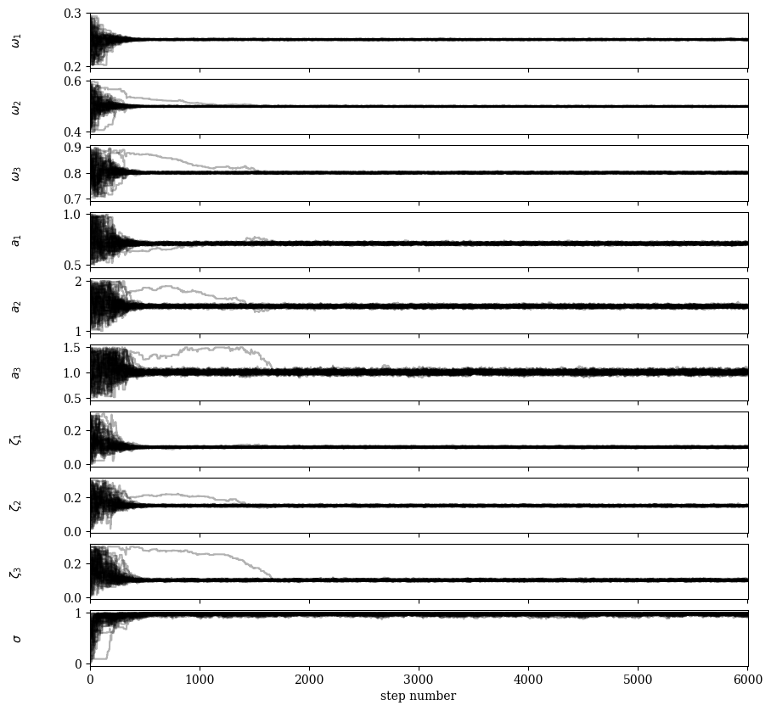
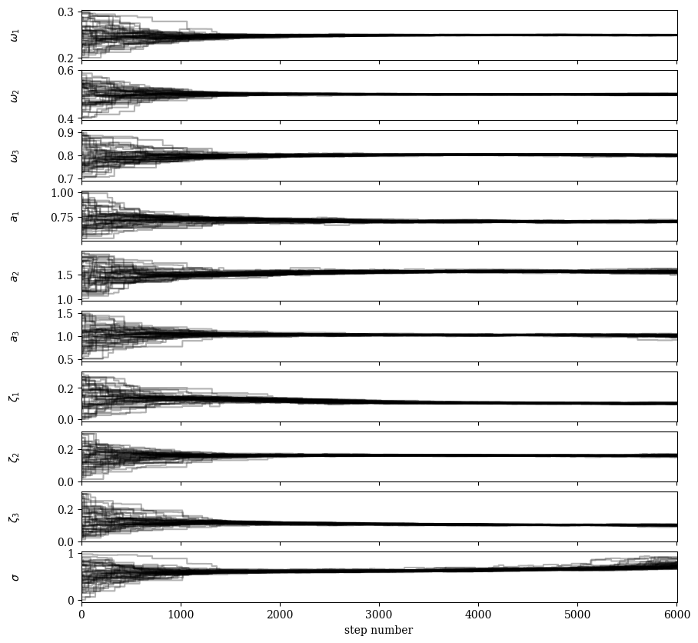
Differential Evolution MCMC (13.8s)
EMCEE (0.4s), 50 walkers (both methods)

Slide 5
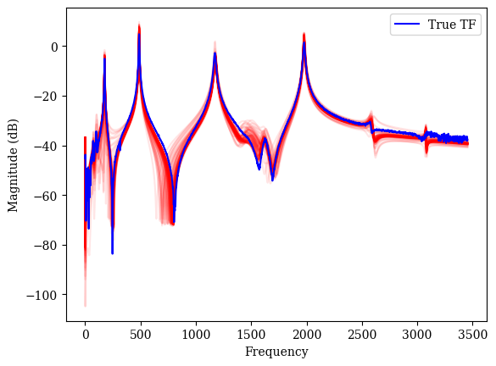
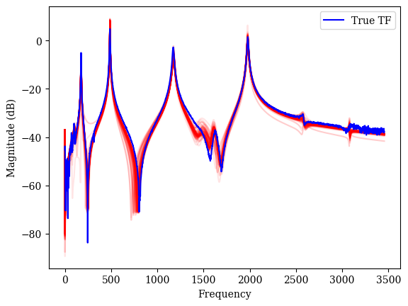
New package implementation of EMCEE appears to be much faster, 50 walkers, 10000 iterations in 2.9 seconds! (1-2 hours previously)
EMCEE performs better than DE-MC on 3C6 data (better convergence in trace plots)
Before burn in:
After burn in:

Slide 6
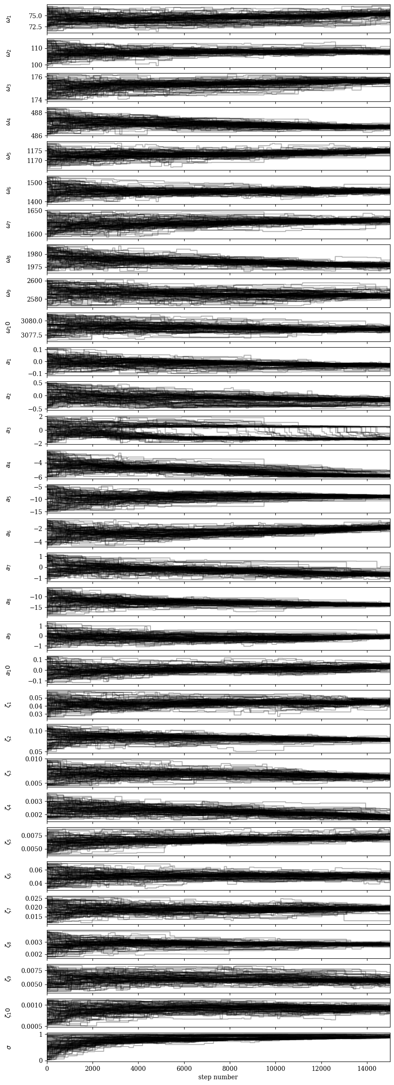
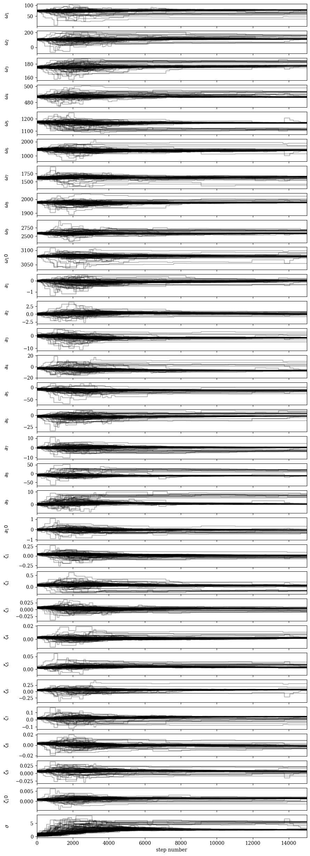
Comparing uniform and Gaussian priors

Slide 7
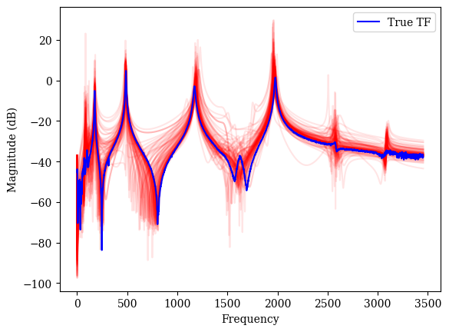
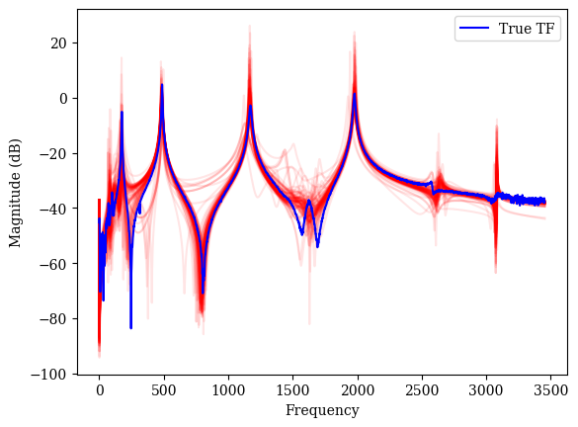
Gaussian priors converging to more extreme modal amplitudes (haven’t spent much time investigating this)

Slide 8
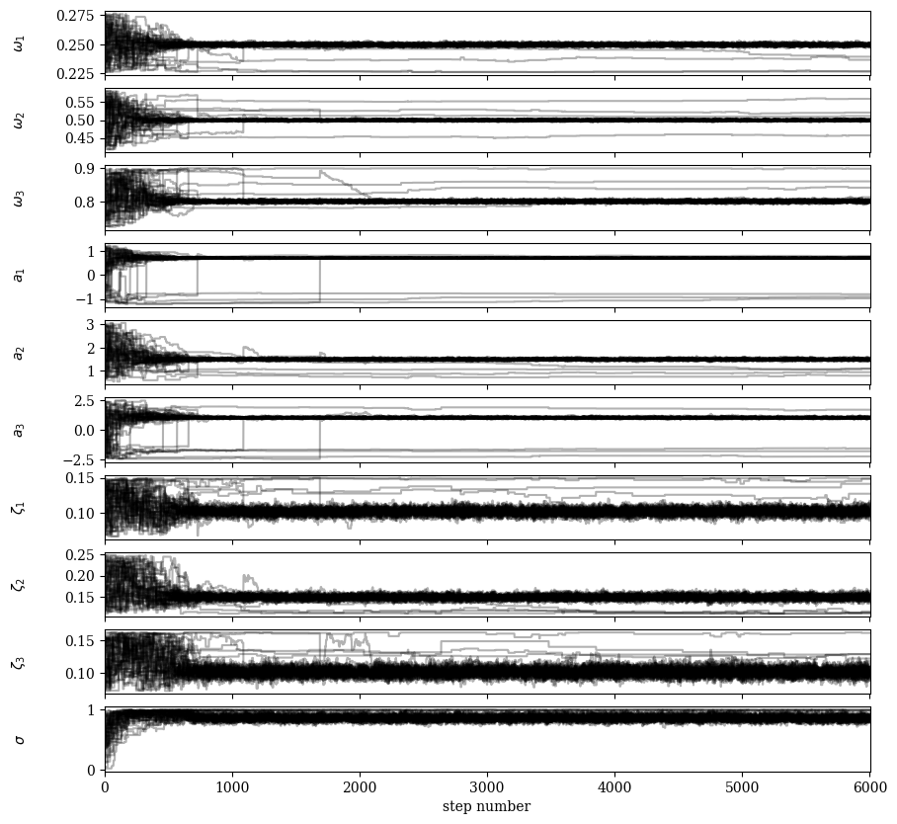
TODO:
Need to automatically discard chains that haven’t converged (can do this based on a probability threshold)
Also could try incorporate model evidence and find the optimal number of modes (iterative method)

